Slide 1

Application of a Convolutional Neural Network for detecting defects in food cans
Rogelio García Álvarez
Machine Learning project. Bootcamp Data Science 2023-2024
08/04/2024

Slide 2
01
Introduction to the Machine Learning project
Motivation
Objective
02
Product and associated defectology
Quantity and typology of the images
Classification of defects
03
Modeling
Image processing
Structure of the model
Key figures and results

Slide 3



Introduction to the Machine Learning project
Motivation
To find a solution to quality escapes in the manufacturing process to improve the two main aspects of the business
€
Production Cost
Production Time
Customer Satisfaction
Brand Image

Slide 4
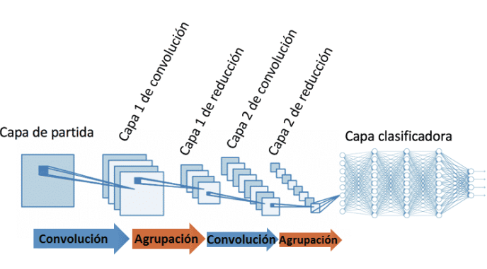
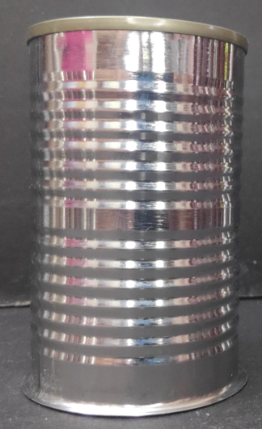
Introduction to the Machine Learning project
Objective
To model a Convolutional Neural Network
Convolutional layer
Convolutional layer
Pooling layer
Pooling layer
Flatten layer
Dense layers
To detect defects in food cans
By applying a combined strategy of automated inspection and manual inspection the quality inspection process is enforced and production costs and times are reduced

Slide 5
Introduction to the Machine Learning project
Why a Deep Learning model?
1.
Learn to distinguish between different types of patterns
2.
Achieve high accuracy in detecting defects, even in cases where human inspectors may miss them
3.
Powerful tool that can be used to improve the efficiency and reliability by identifying and localizing defects early on

Slide 6
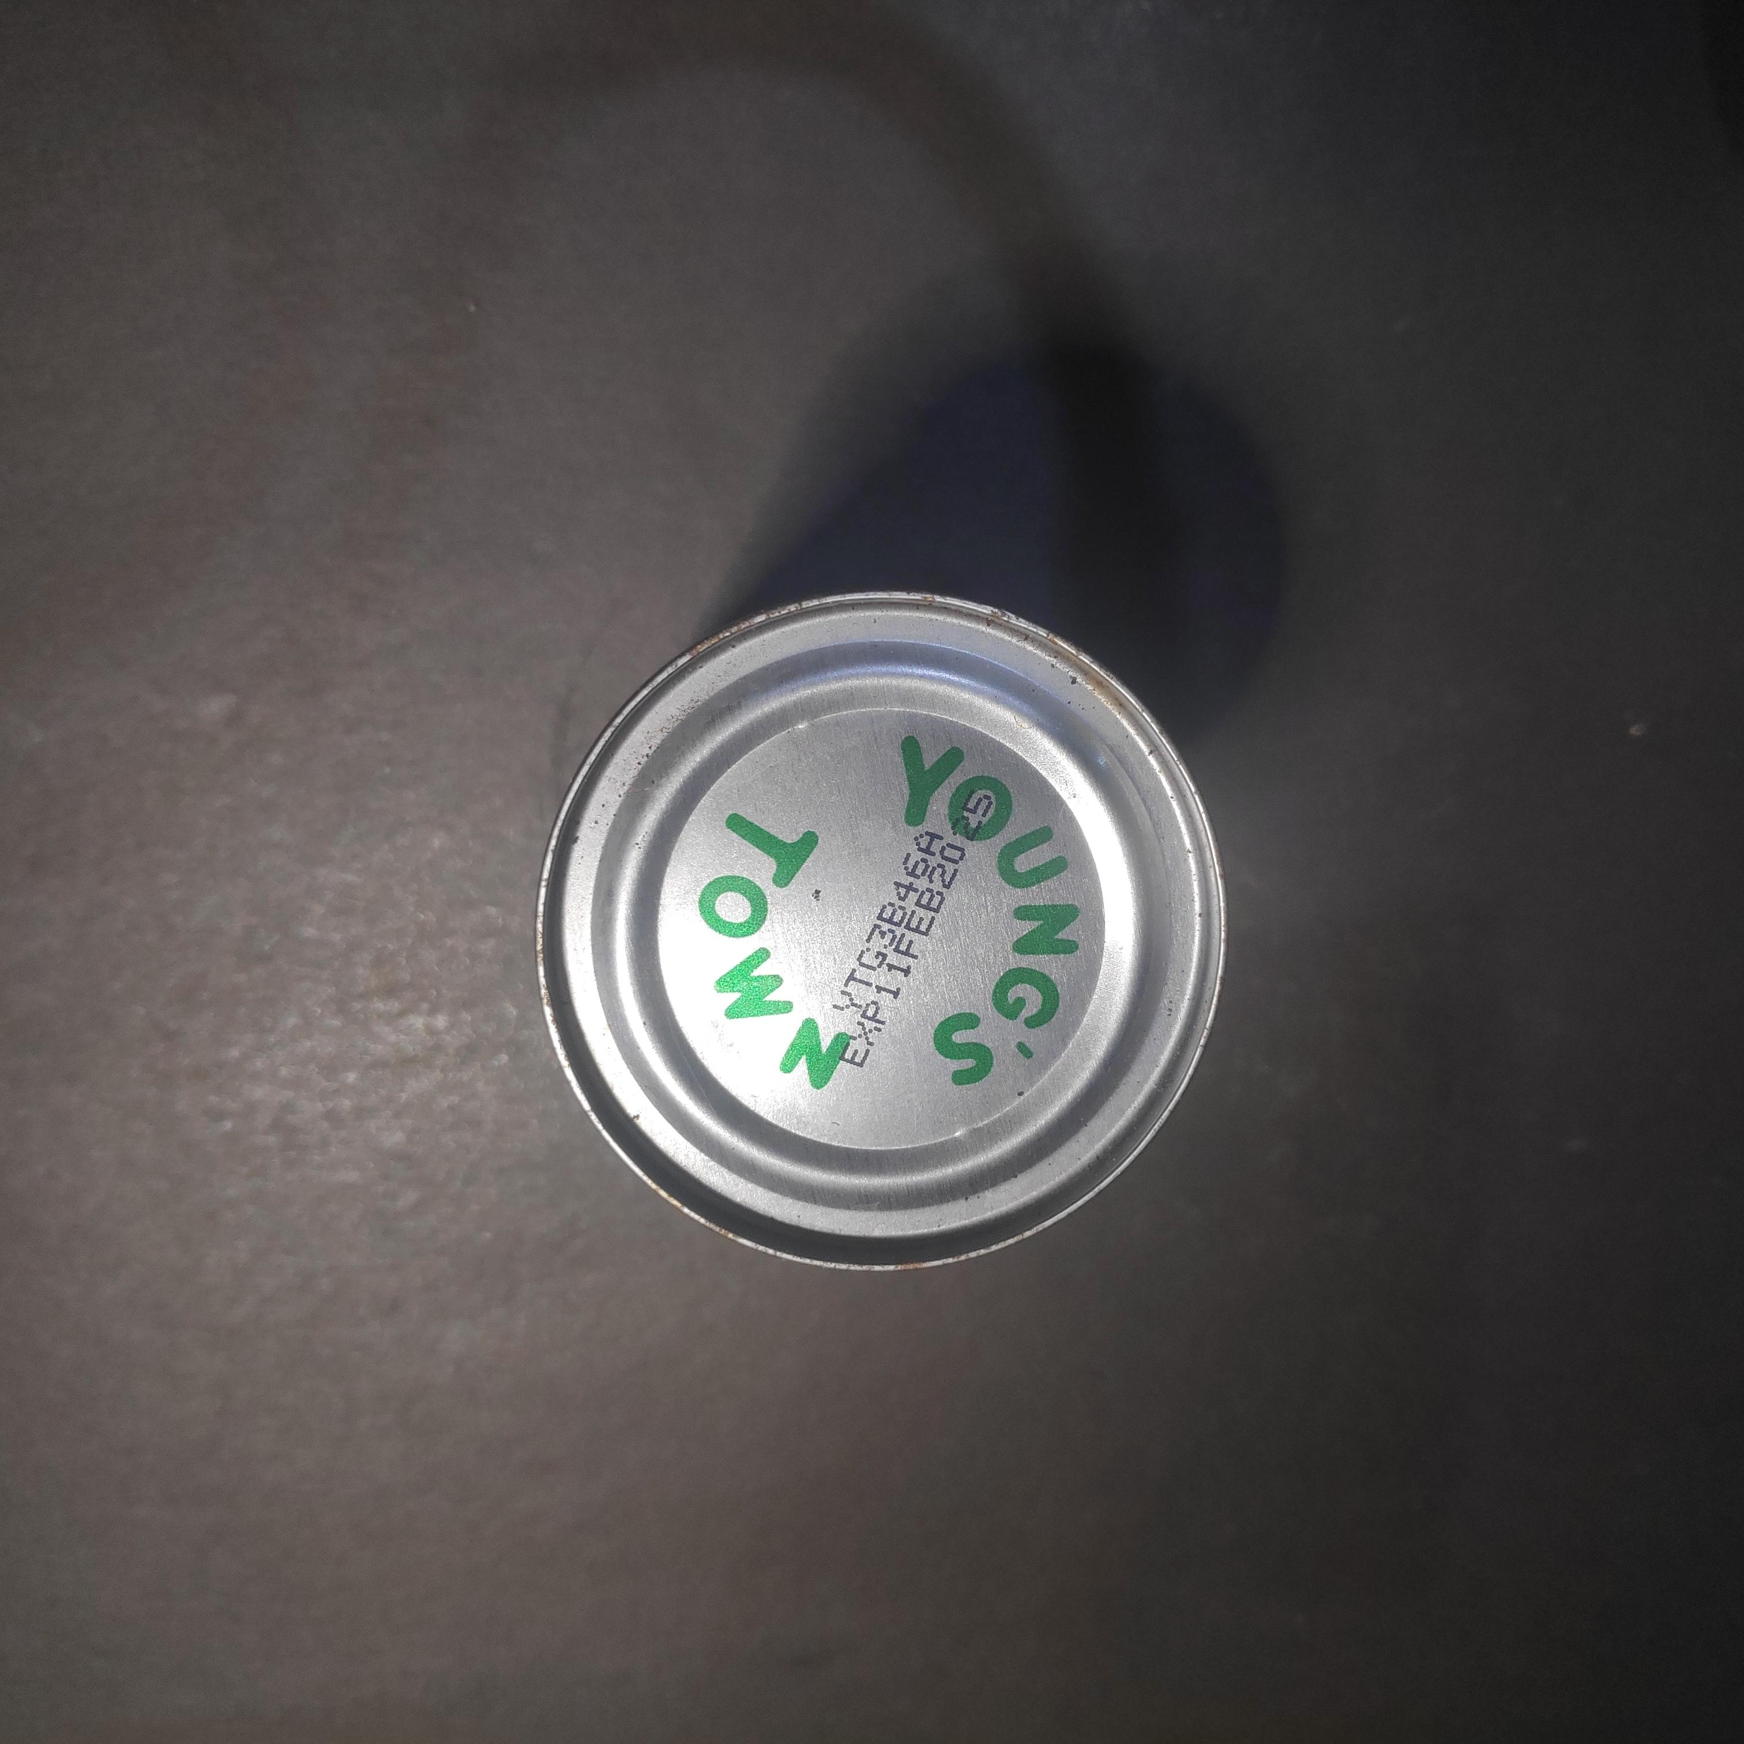

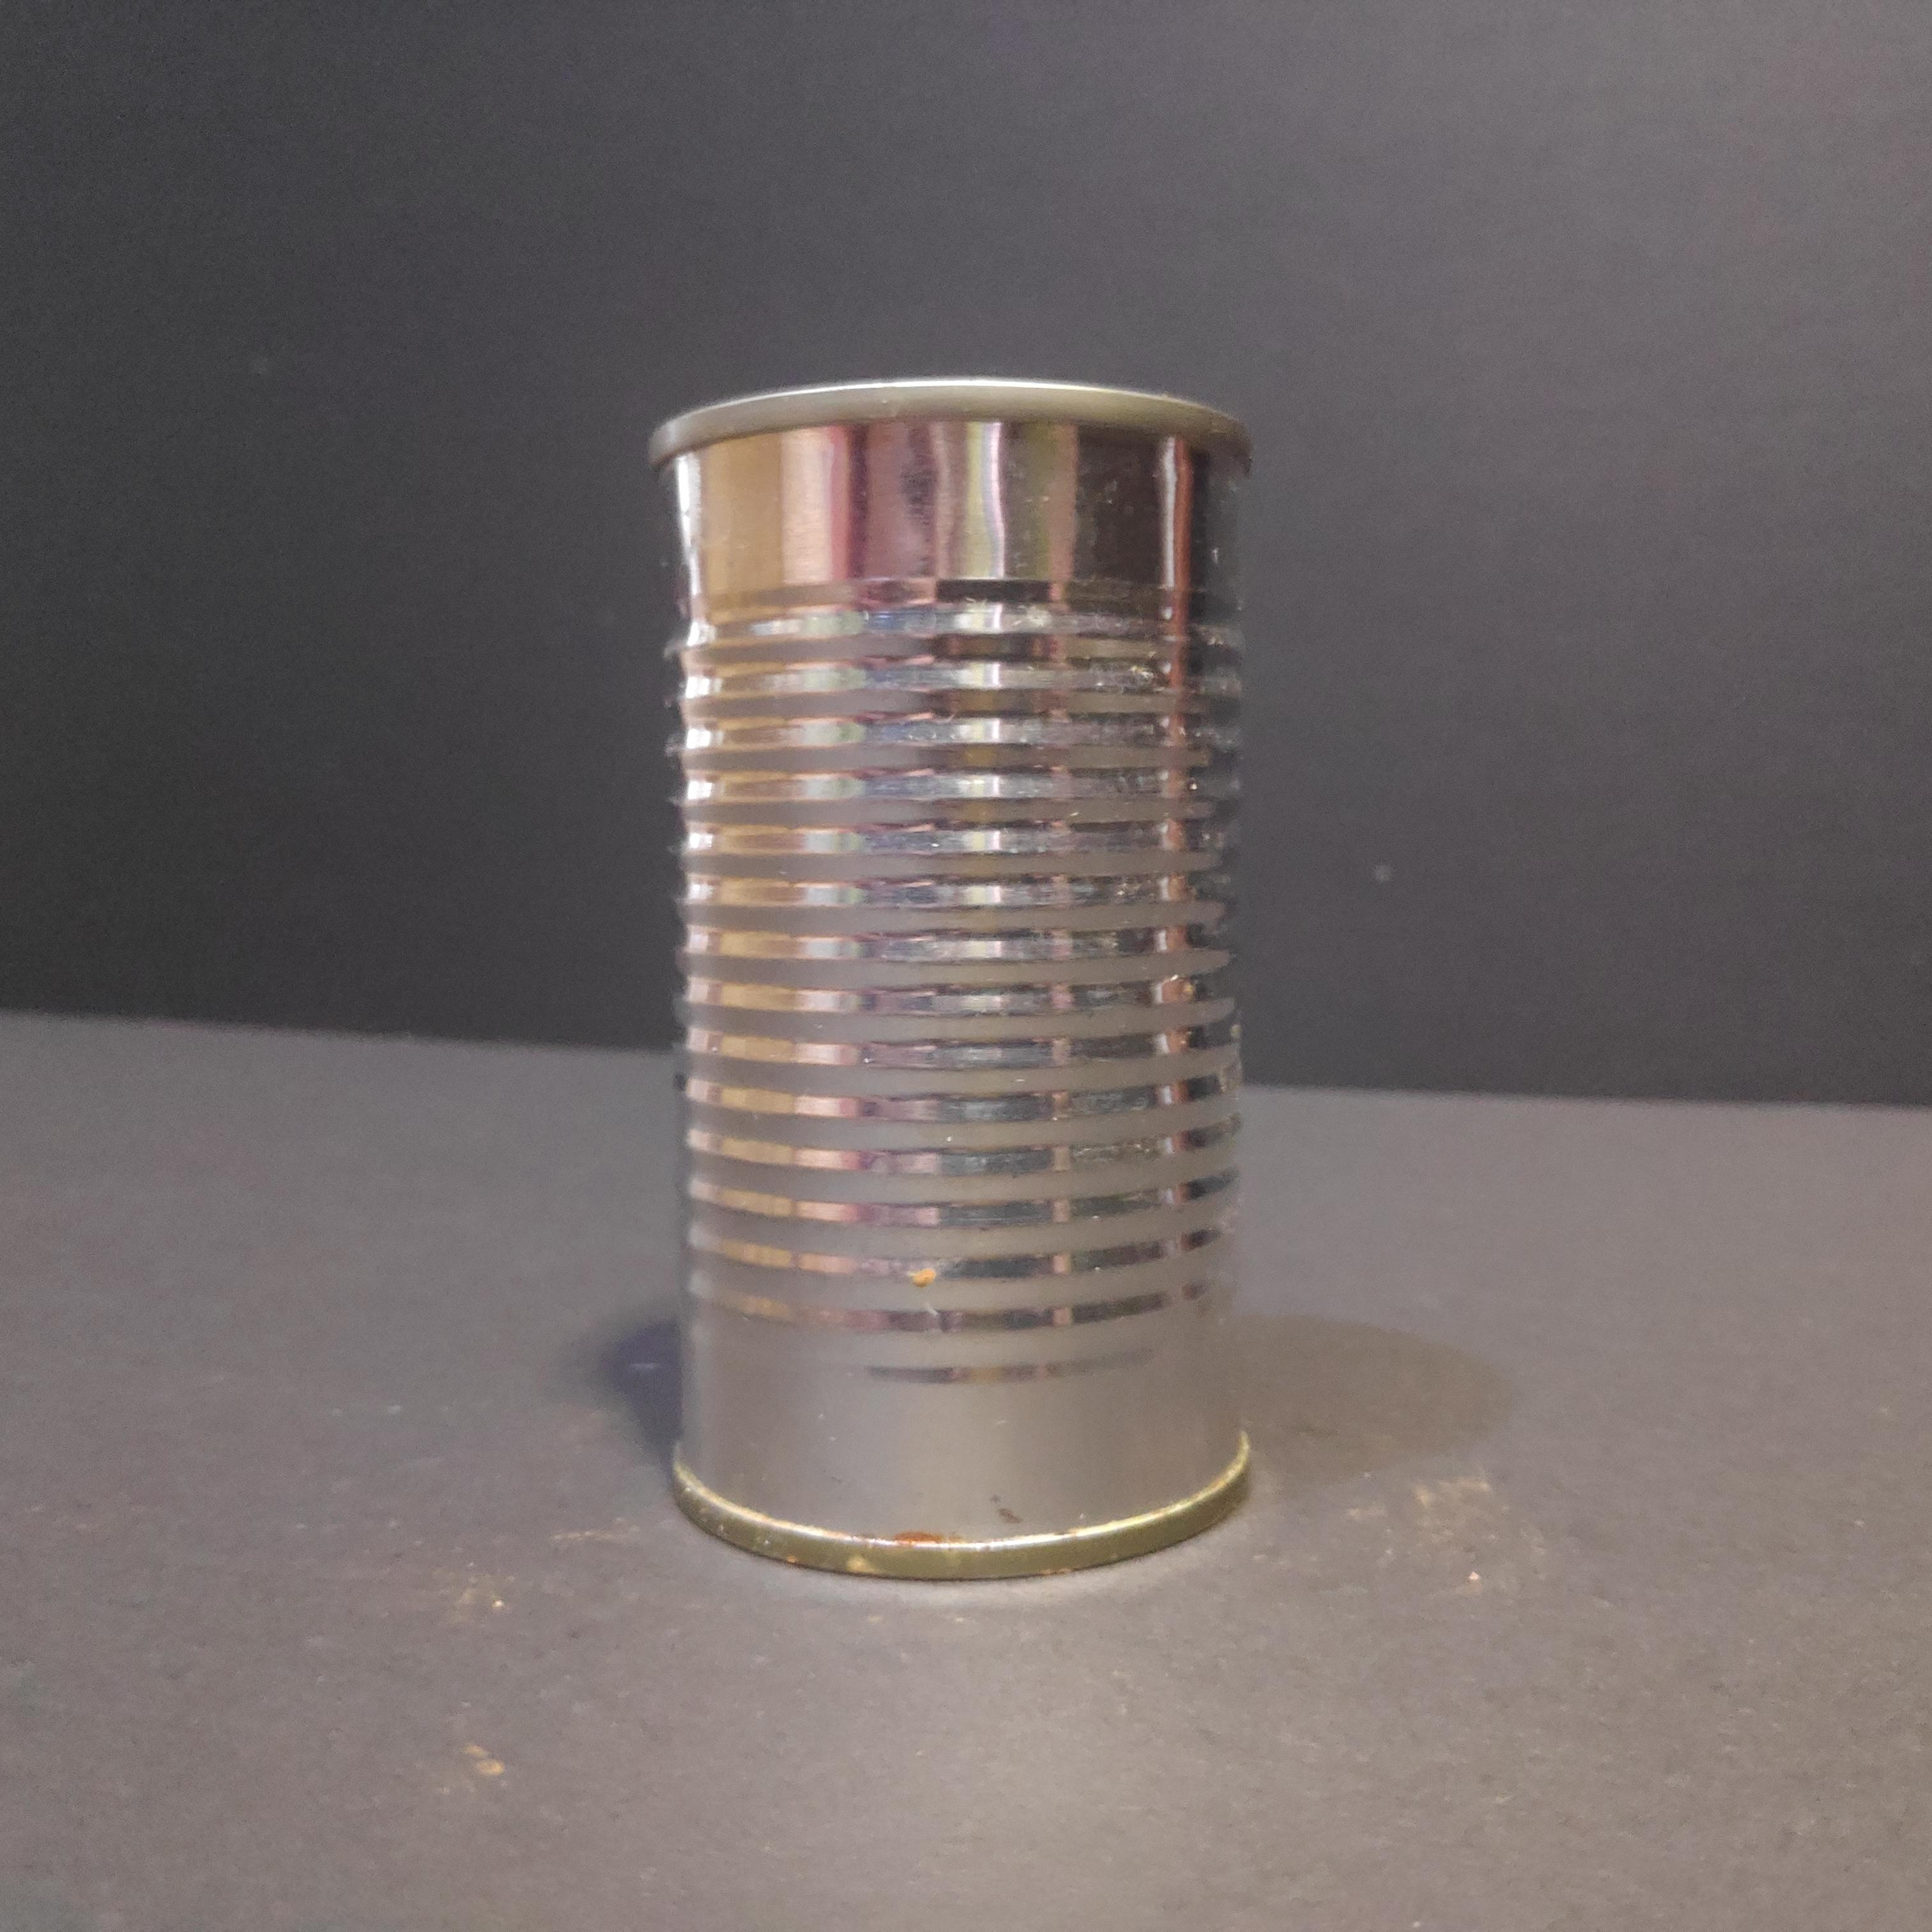
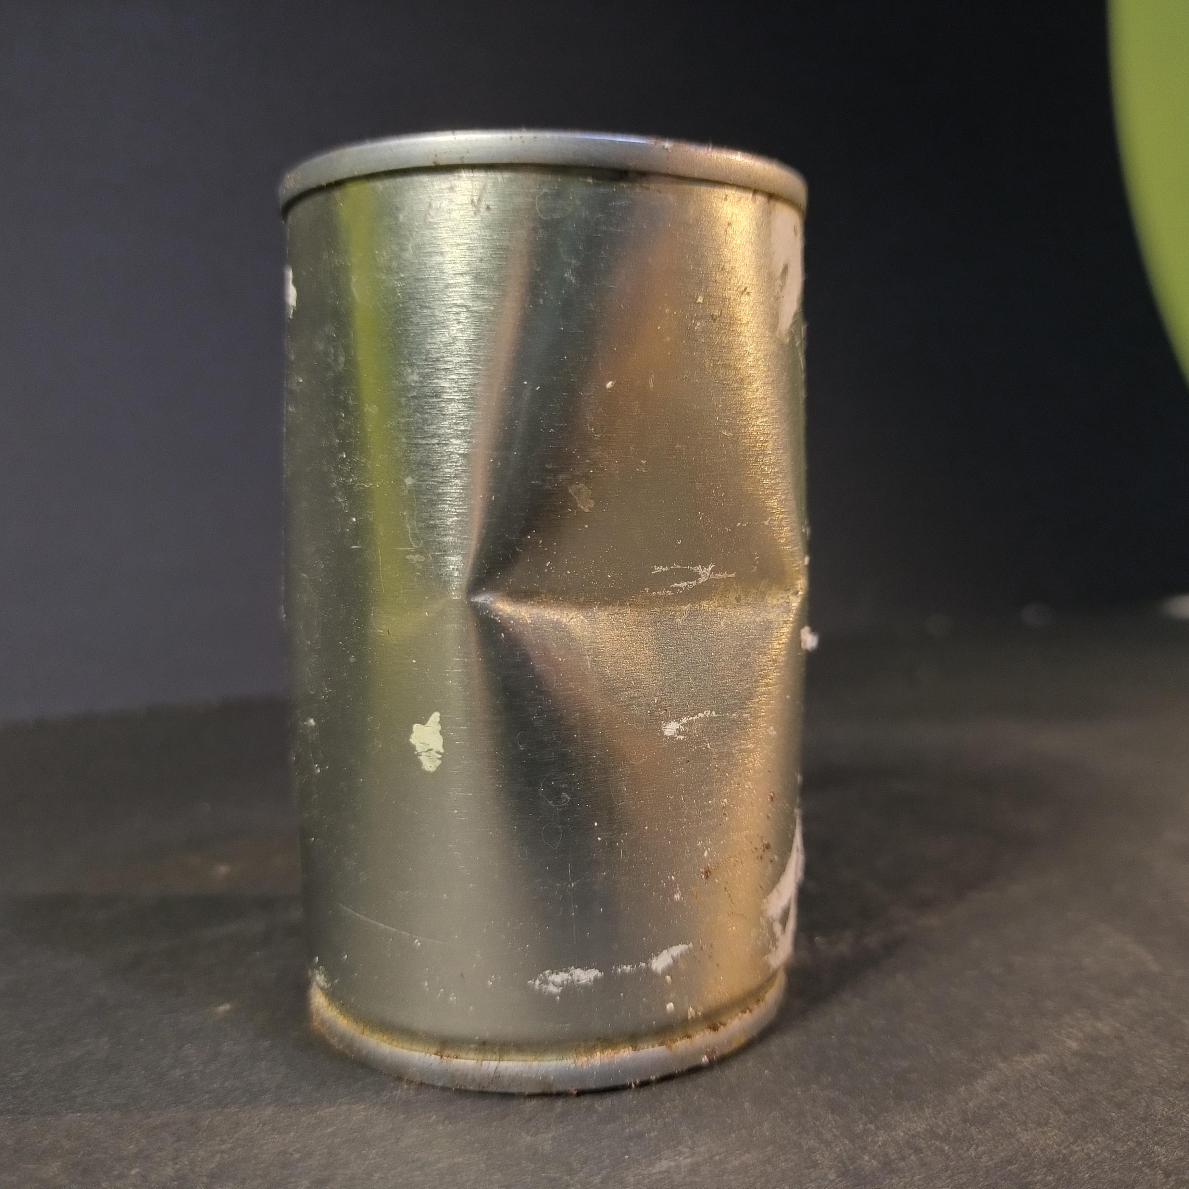

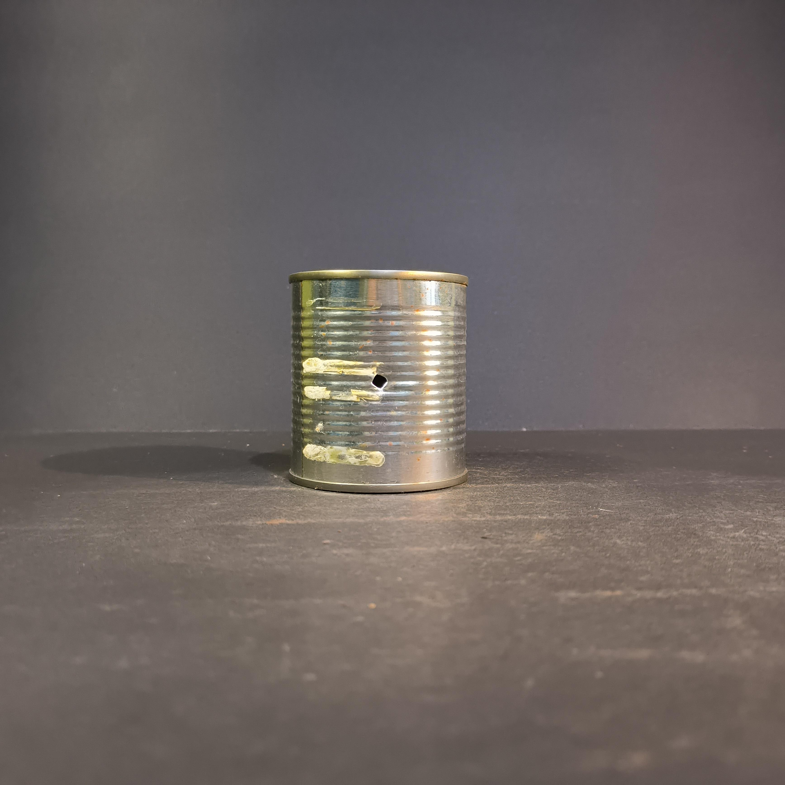
Product and associated defectology
Quantity and typology of the images
Top view
Front view
Quantity
Train 5.658 images
Validation 1.609 images
Test 828 images

Slide 7
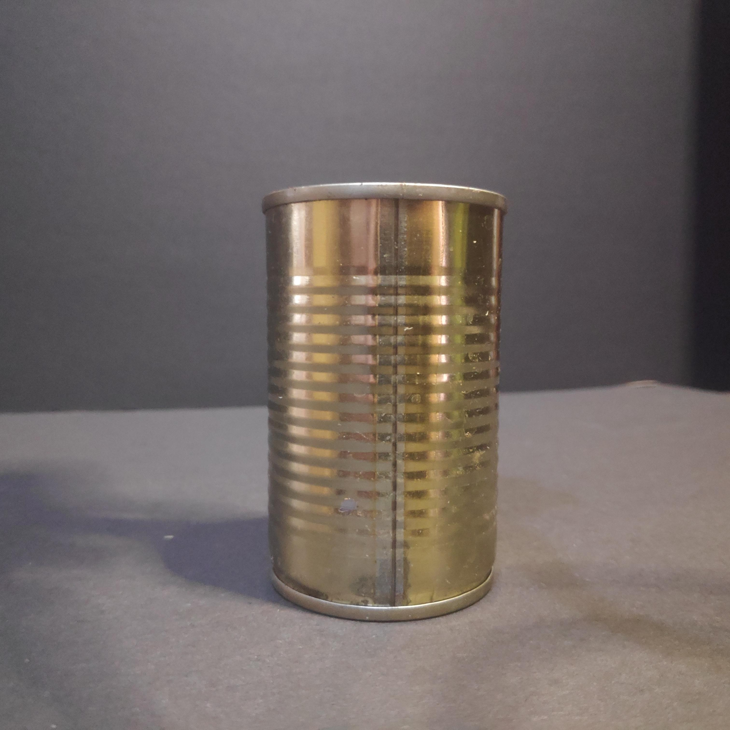
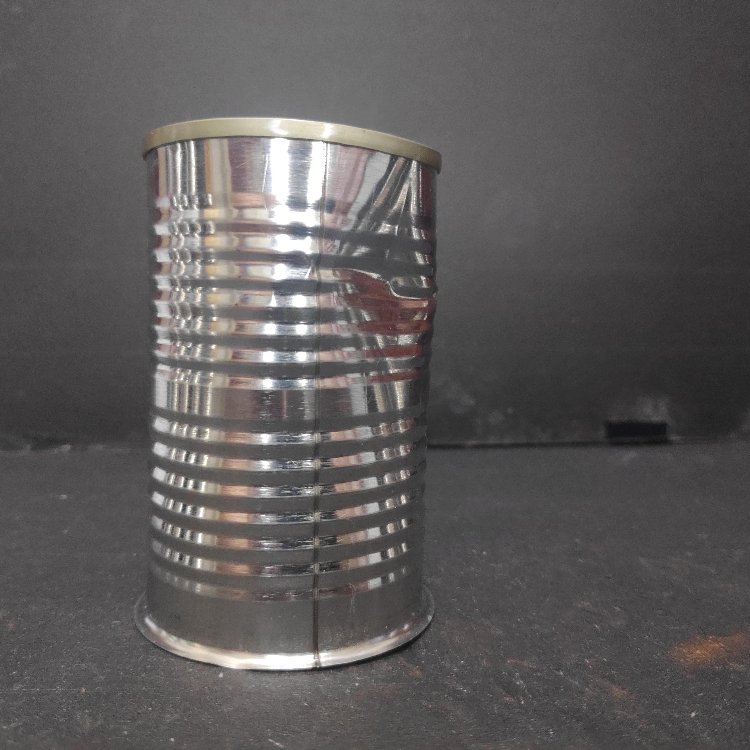
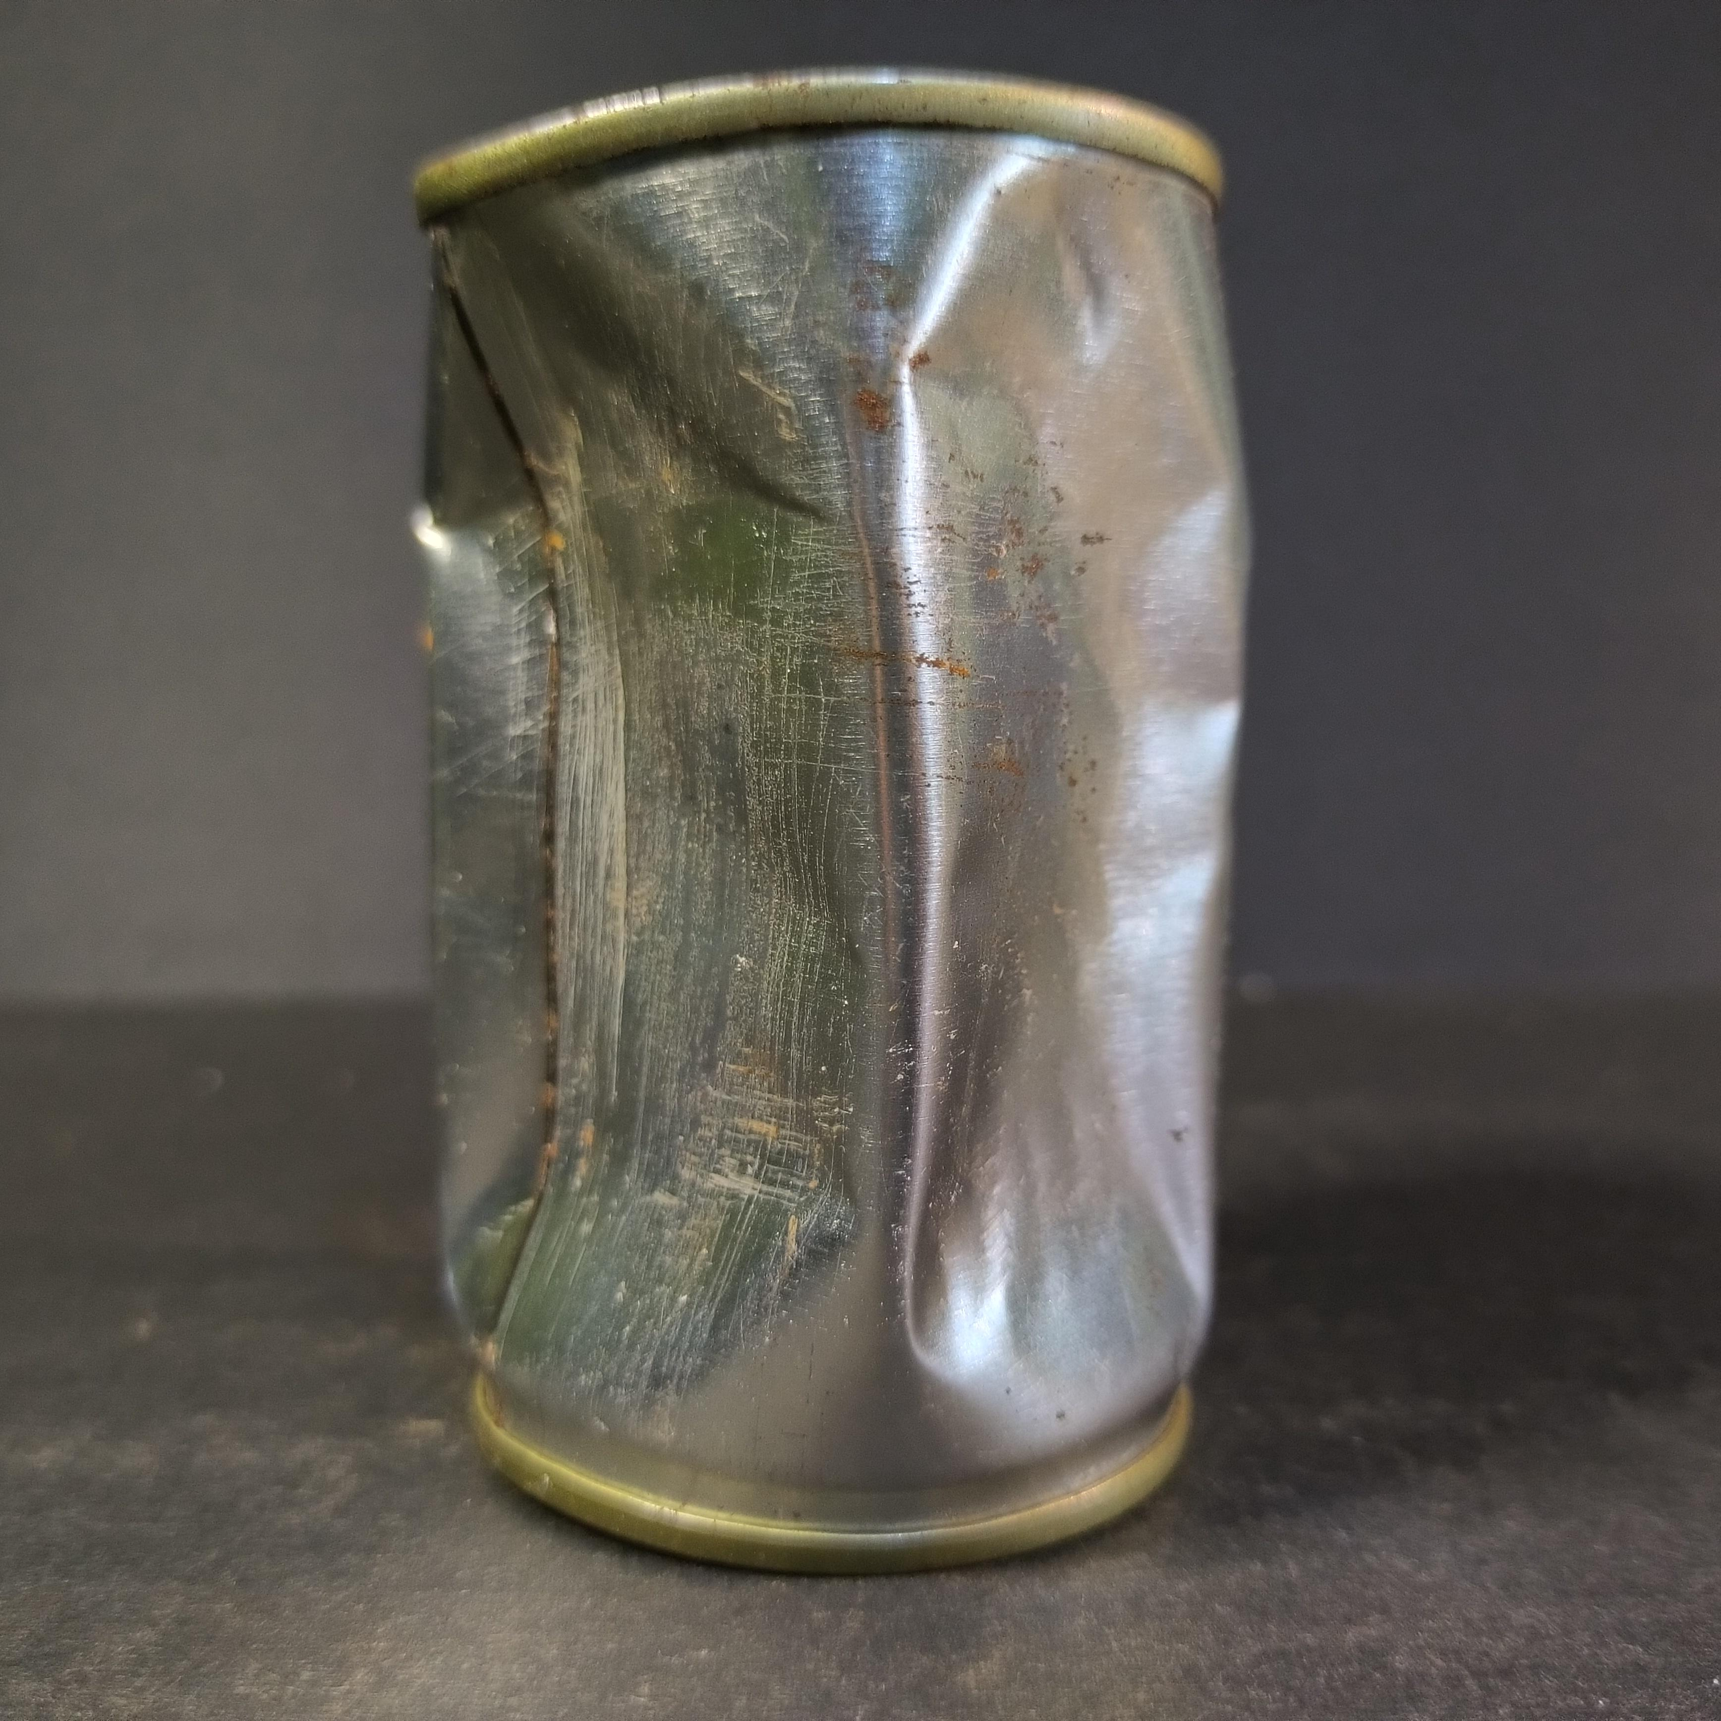
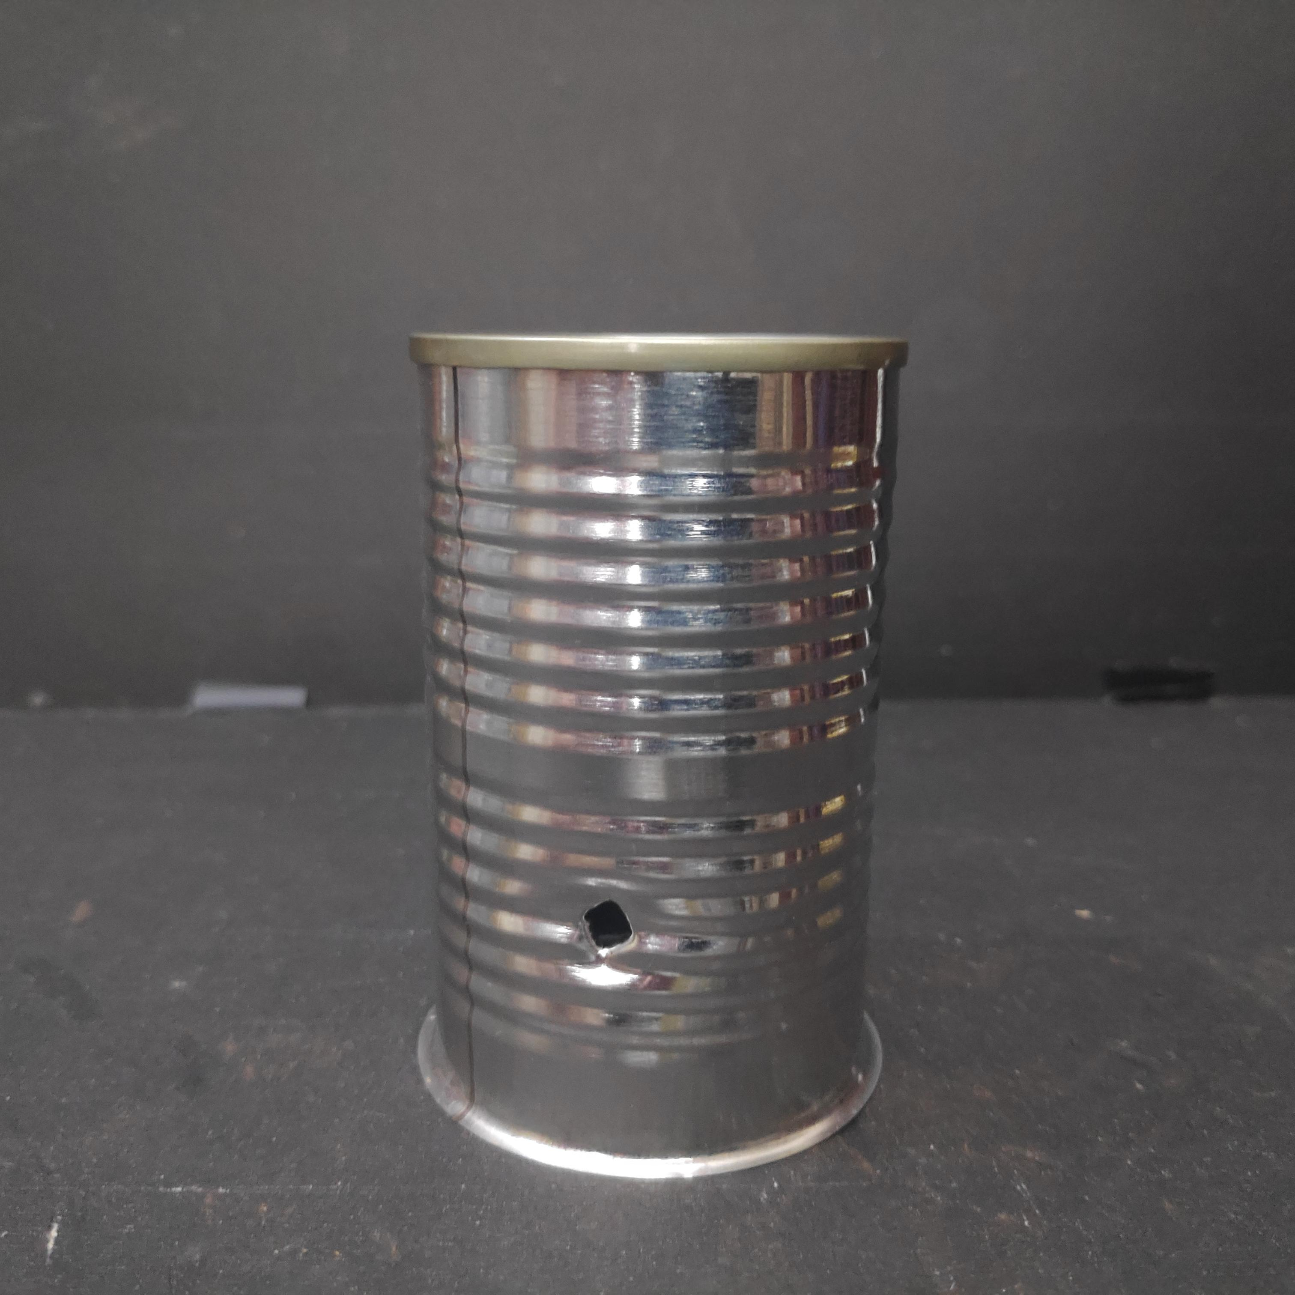
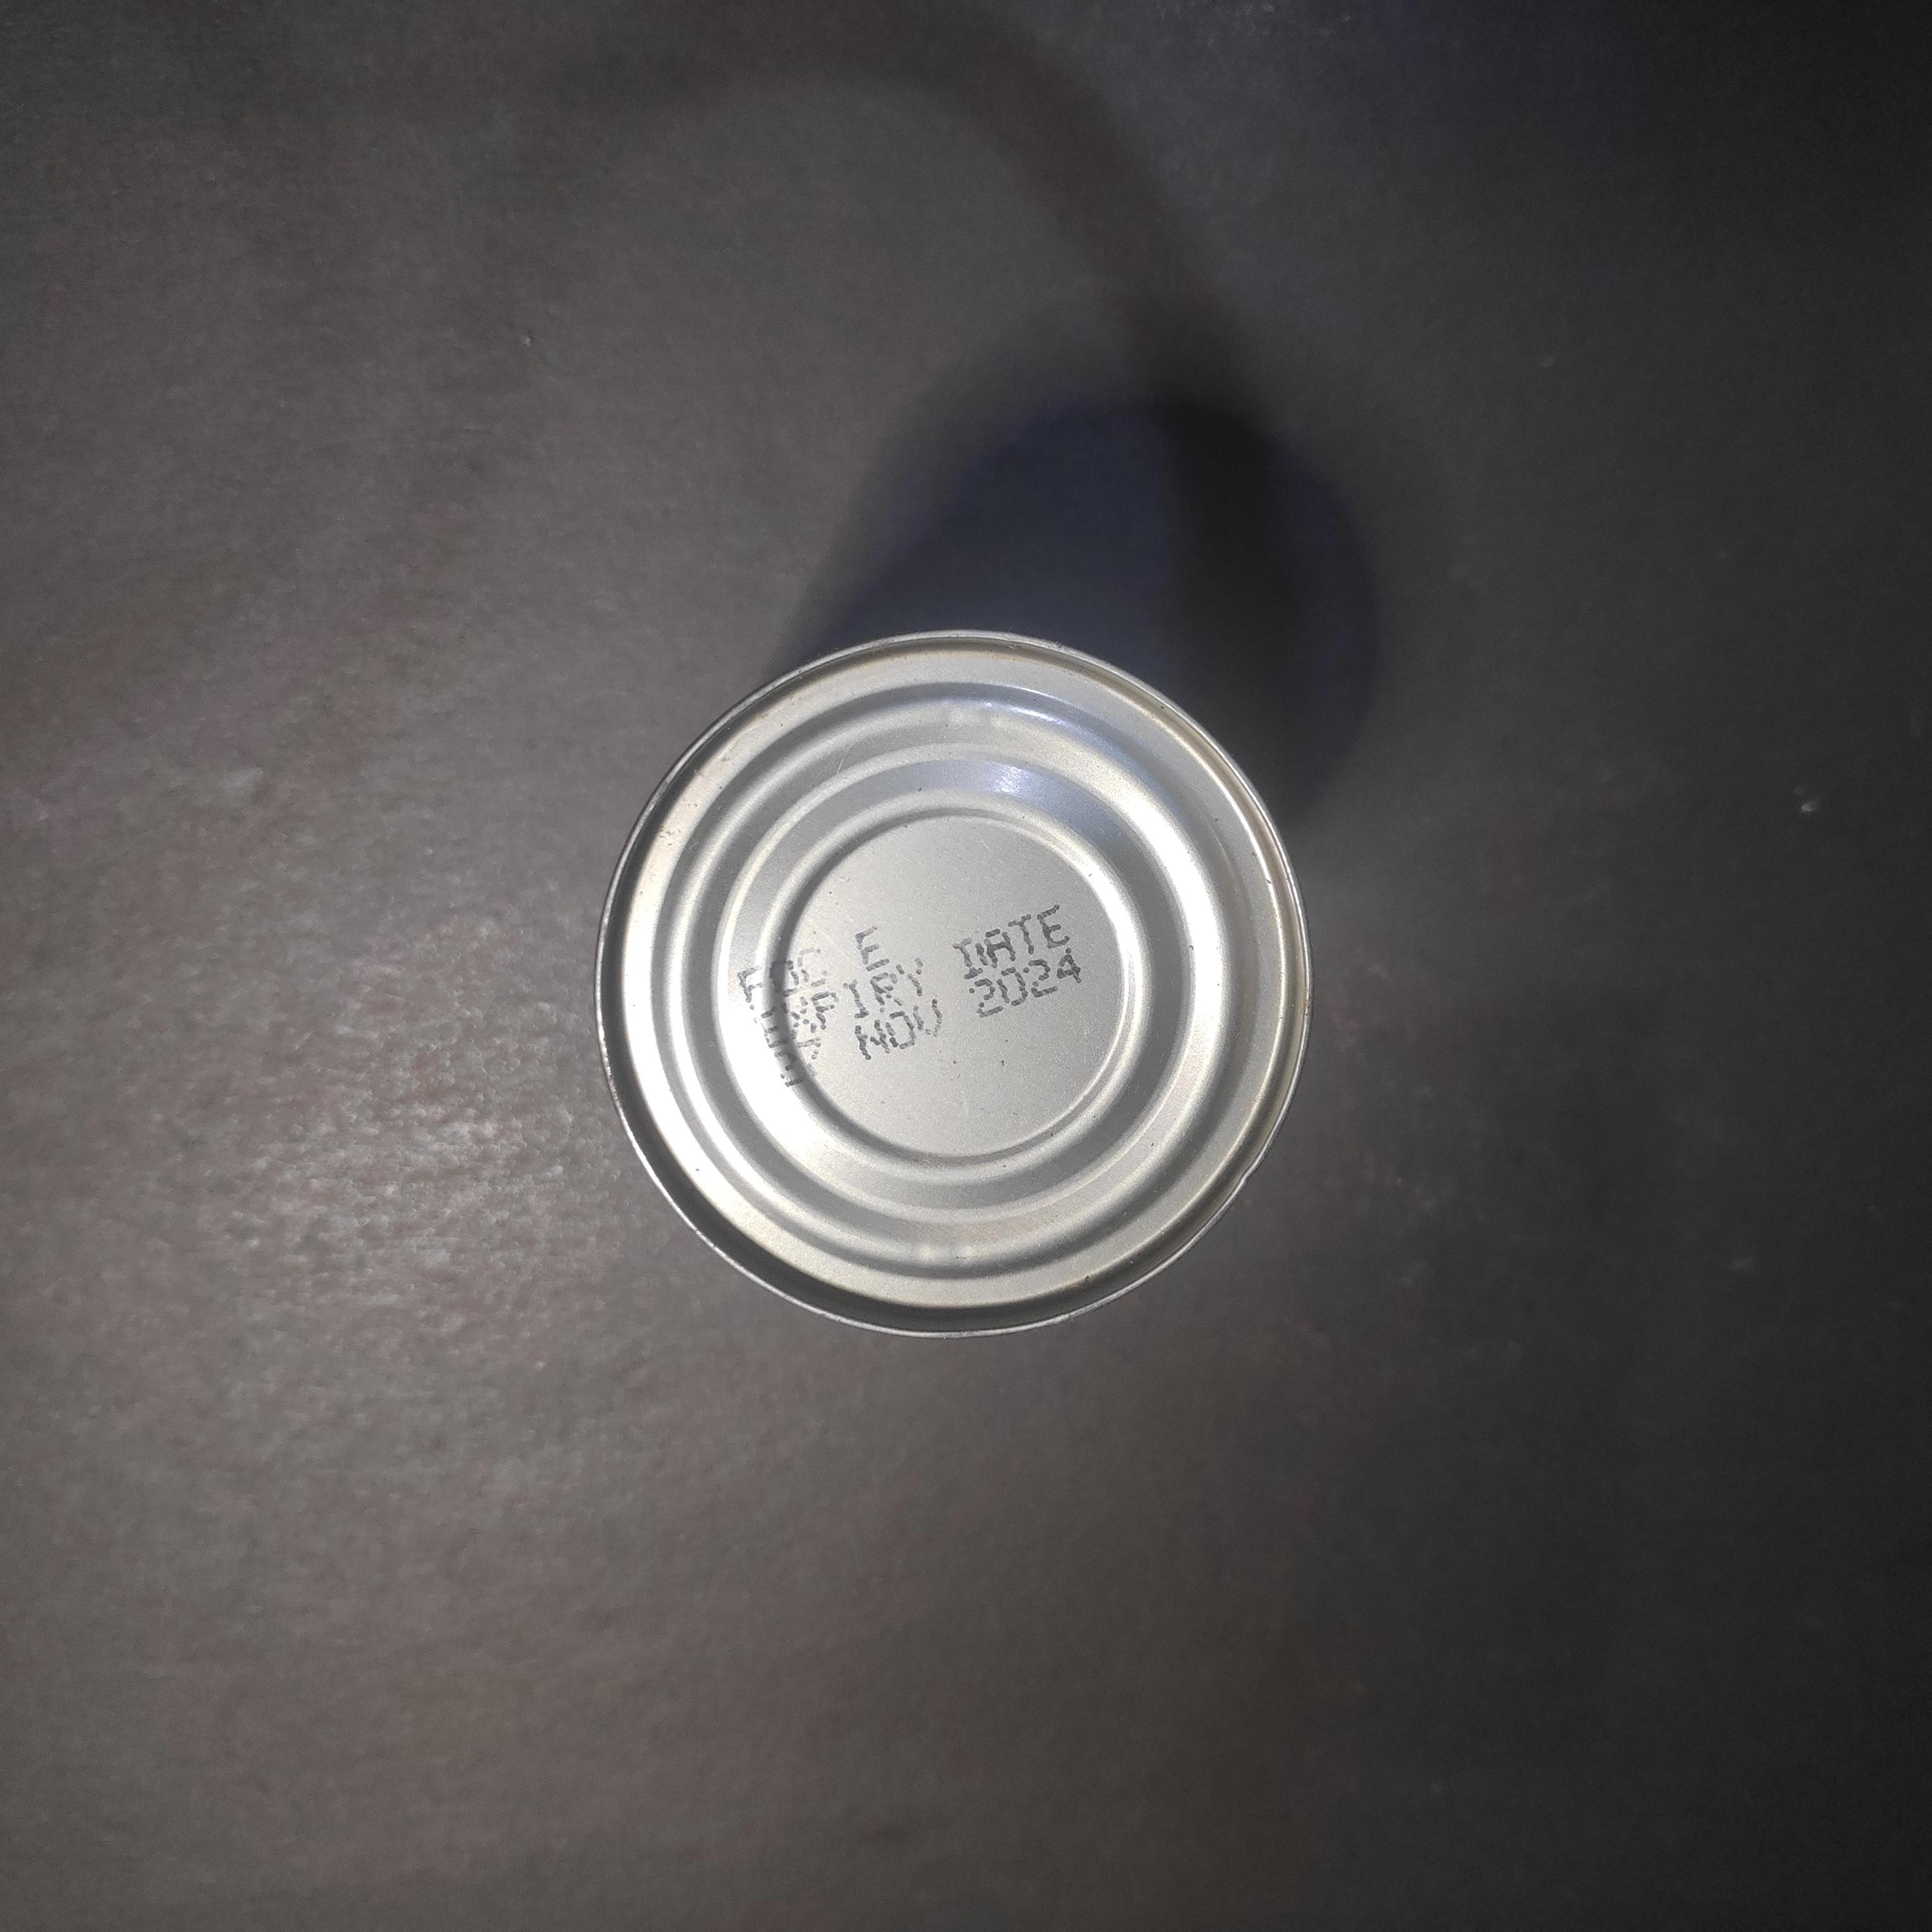
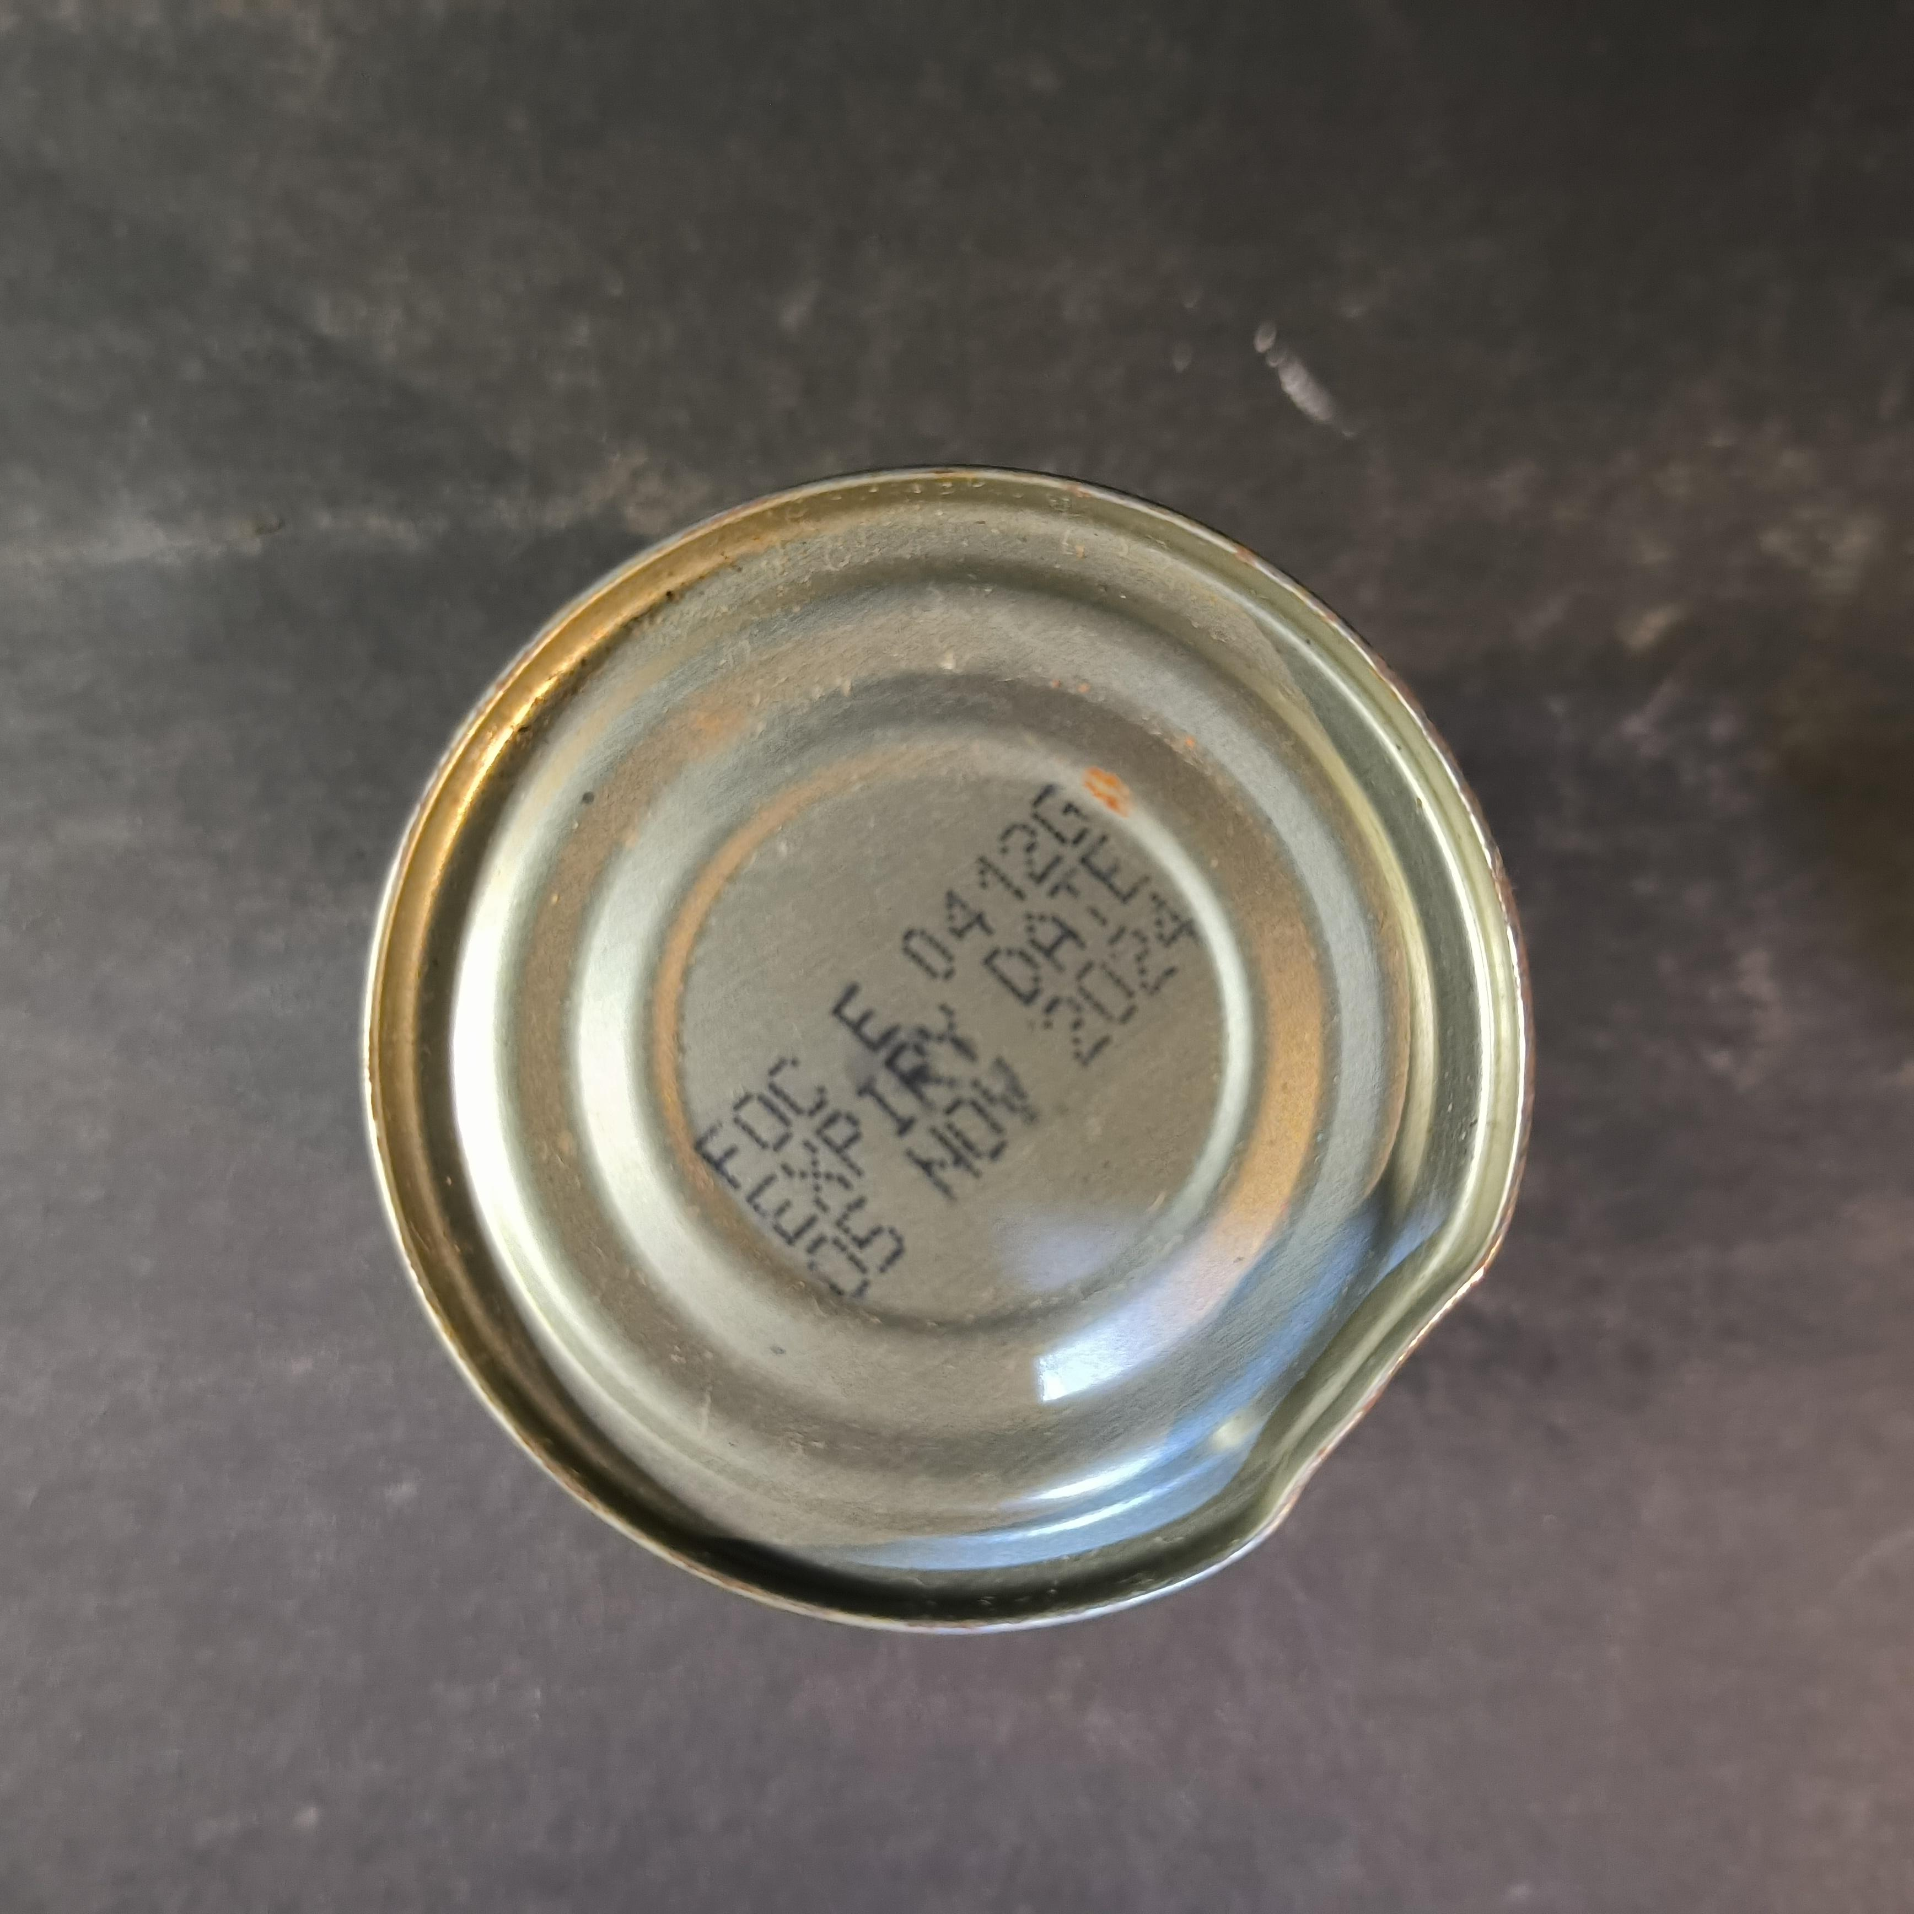
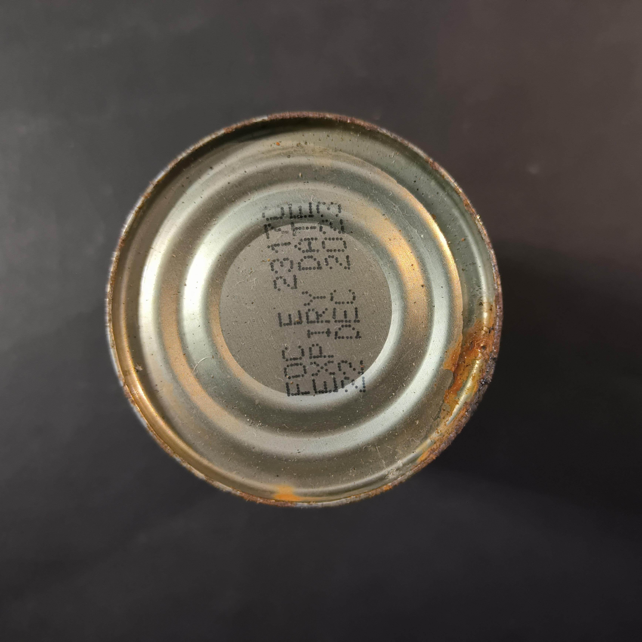
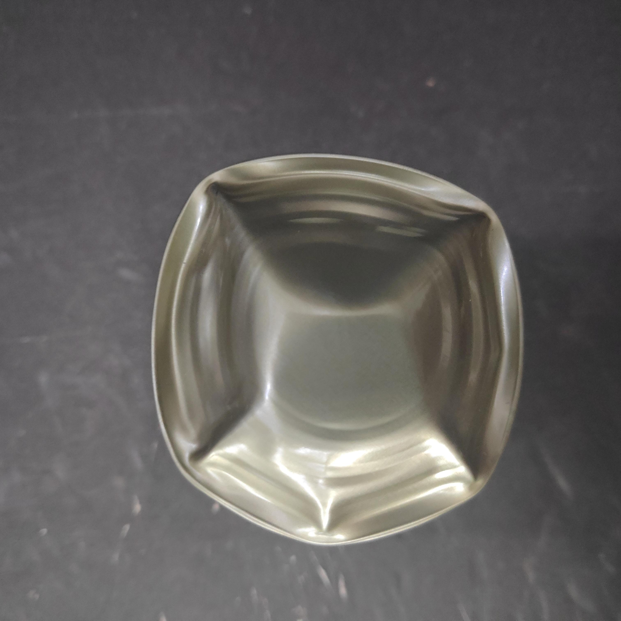
Product and associated defectology
Classification of defects
No defect
Minor defect
Major defect
Critical defect
Non-defective
Defective

Slide 8
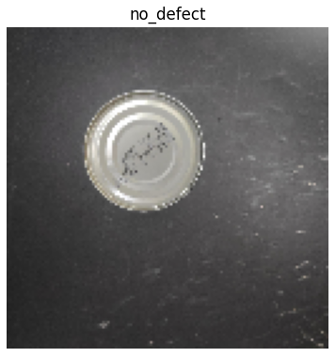
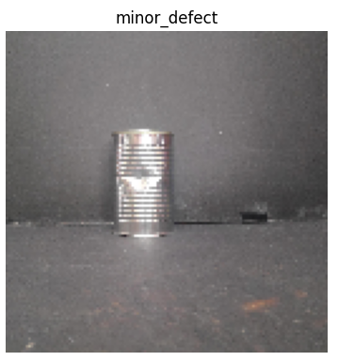

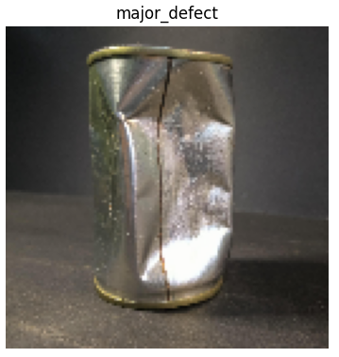
Modeling
Image processing
Classification into folders for reading
Resizing to 128 x 128 pixels
test
no_defect
minor_defect
can_defects
train
valid
major_defect
critical_defect

Slide 9
Modeling
Structure of the model
Convolutional layer (16 filters)
FLATTEN LAYER
Convolutional layer (8 filters)
DROPOUT (rate=0.5)
Pooling layer
DROPOUT (rate=0.5)
Pooling layer
1.024 features
Kernel size = (5,5)
Stride = (2,2)
Pool size = (2,2)
Stride = (2,2)
Kernel size = (3,3)
Stride = (2,2)
Pool size = (2,2)
Stride = (2,2)
Feature extraction

Slide 10
Modeling
Structure of the model
Activation = “Sigmoid”
Activation = “Softmax”
Binary classification
Multiclass classification
DENSE LAYER (1.024 UNITS)
OUTPUT LAYER (1 UNIT)
DENSE LAYER (1.024 UNITS)
OUTPUT LAYER (4 UNITS)
no_defect
DROPOUT (rate=0.5)
DROPOUT (rate=0.5)
no_defect
minor_defect
1.024 features
1.024 features
defect
major_defect
critical_defect
Classification
Classification

Slide 11
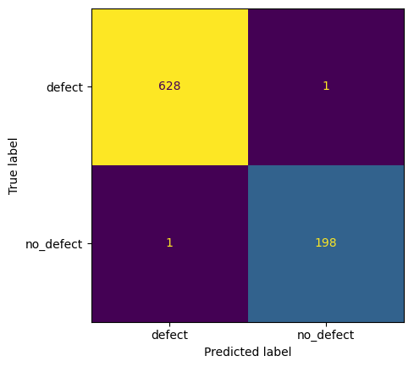
Modeling
Key figures and results (binary classification)
Training time 3 minutes
Test accuracy 99,76%

Slide 12
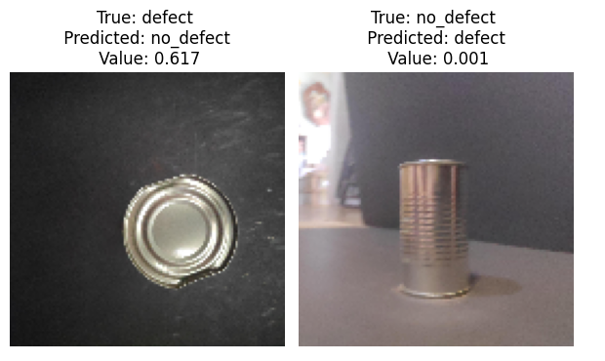
Modeling
Key figures and results (binary classification)
Incorrect classification: 2 of 828 images

Slide 13
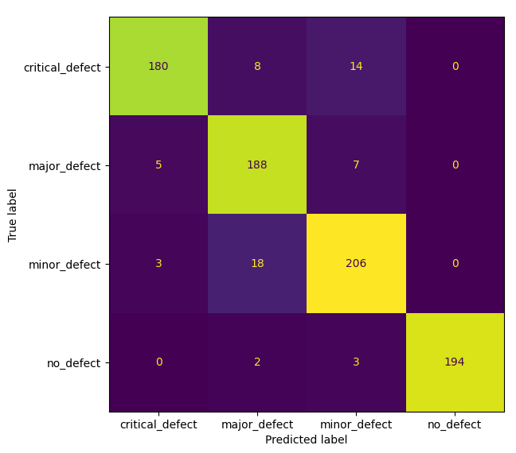
Modeling
Key figures and results (multiclass classification)
Training time 2 minutes
Test accuracy 92,75%

Slide 14
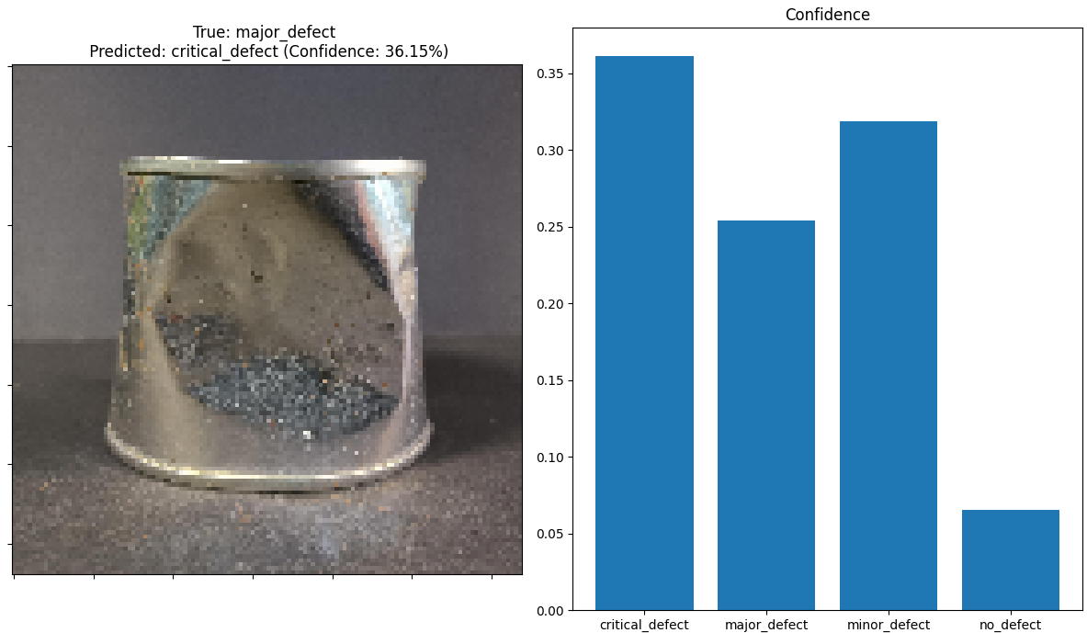
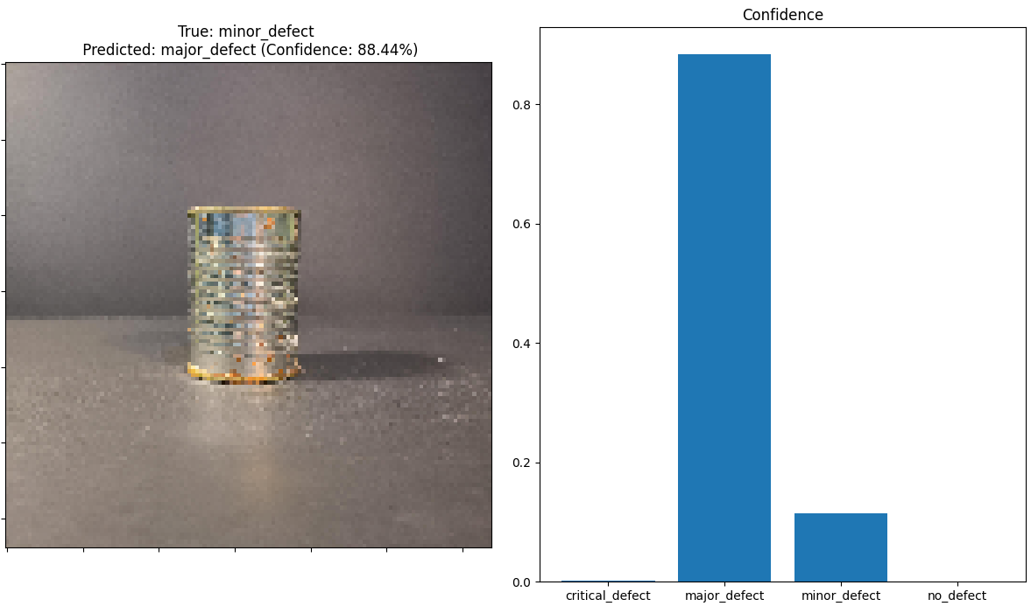
Modeling
Key figures and results (multiclass classification)
Incorrect classification: 60 of 828 images

Slide 15
Thank you for your attention
Rogelio García Álvarez
Machine Learning project. Bootcamp Data Science 2023-2024
08/04/2024

